Slide 1
Changes on what is the mammal layer:
Previously: all mammals (deleted)
Now: all mammals minus bat hosts (mmb)
Inclusion of all bovidae livestock in comparison with cattle: present cattle OR bovidae livestock in the main text and the other in the supplements.
Changes in scenario 2: tests with 4 scenarios
Scenario 2 cattle: Bat Hosts + mammals mmb + pig + cattle + everything else
Scenario 2 all bovidae: Bat Hosts + mammals mmb + pig + bovidae livestock + everything else
Reason to stay: nested with scenario 1. ‘It is the reality’, as every layer is out there
Reason to delete: it pushes away from checking differences with scenario one.
Scenario 2 no bat hosts cattle: mammals mmb + pig + cattle + everything else
Scenario 2 no bat hosts all bovidae: mammals mmb + pig + bovidae livestock + everything else
Reason to stay: Because it is nested with scenario 1, we can see differences better (‘bat host’ excess can be approximated to bigger risks, or a model focused on SARS-like covs in scenario 1, while scenario 2 is general risk of zoonotic infectious diseases)
Reason to delete:

Slide 2



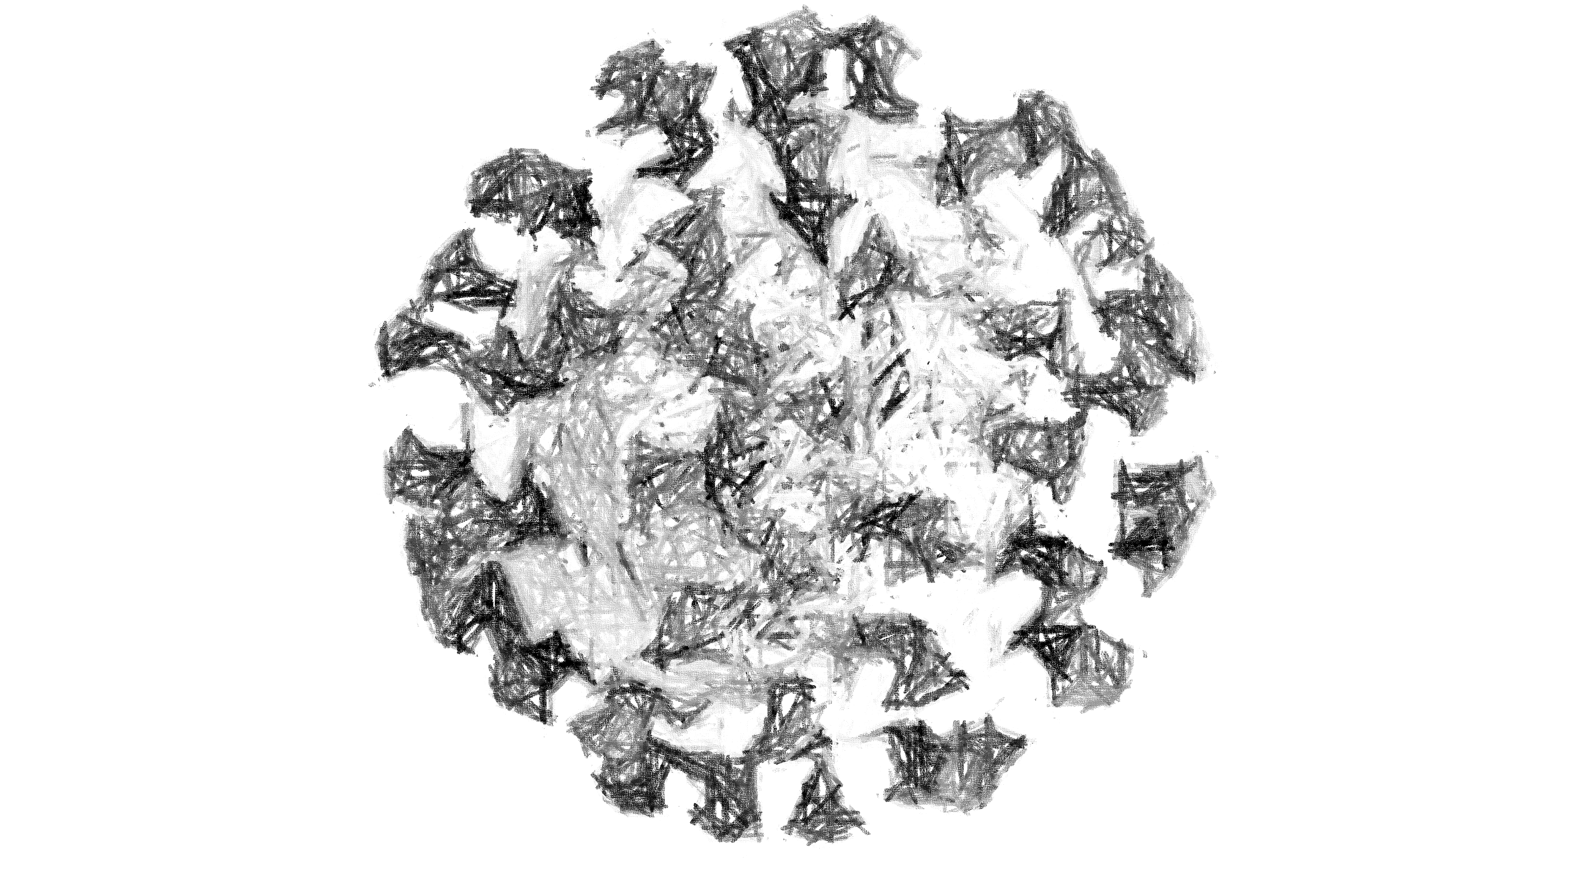
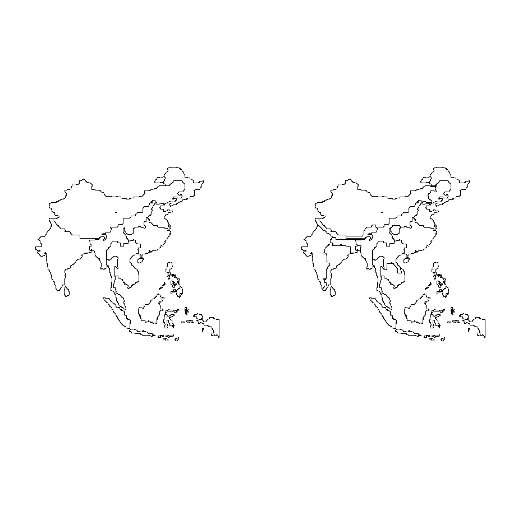
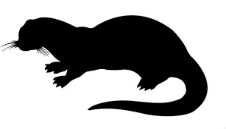

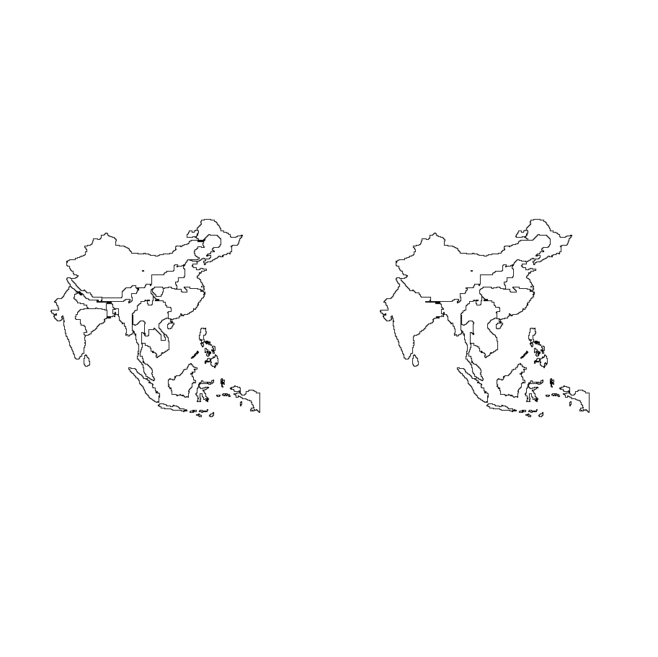
9 clusters
cattle
19 clusters
19 clusters
9 clusters
all bovidae livestock

Slide 3
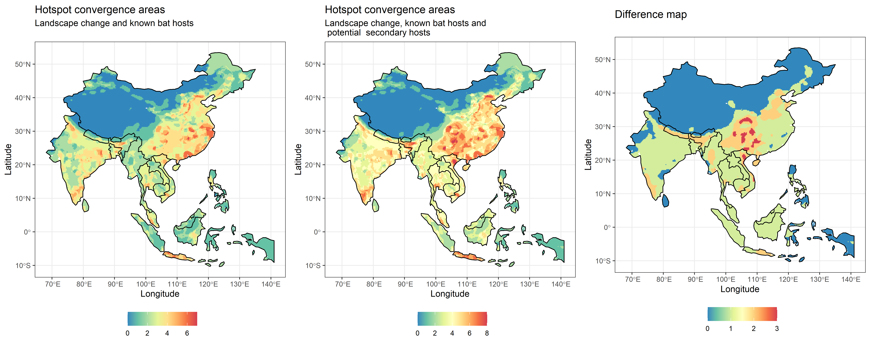
Figure 2 nested
table(db$n_hotspots_risk2 - db$n_hotspots_risk1)
0 1 2 3
12093 10569 2816 318

Slide 4
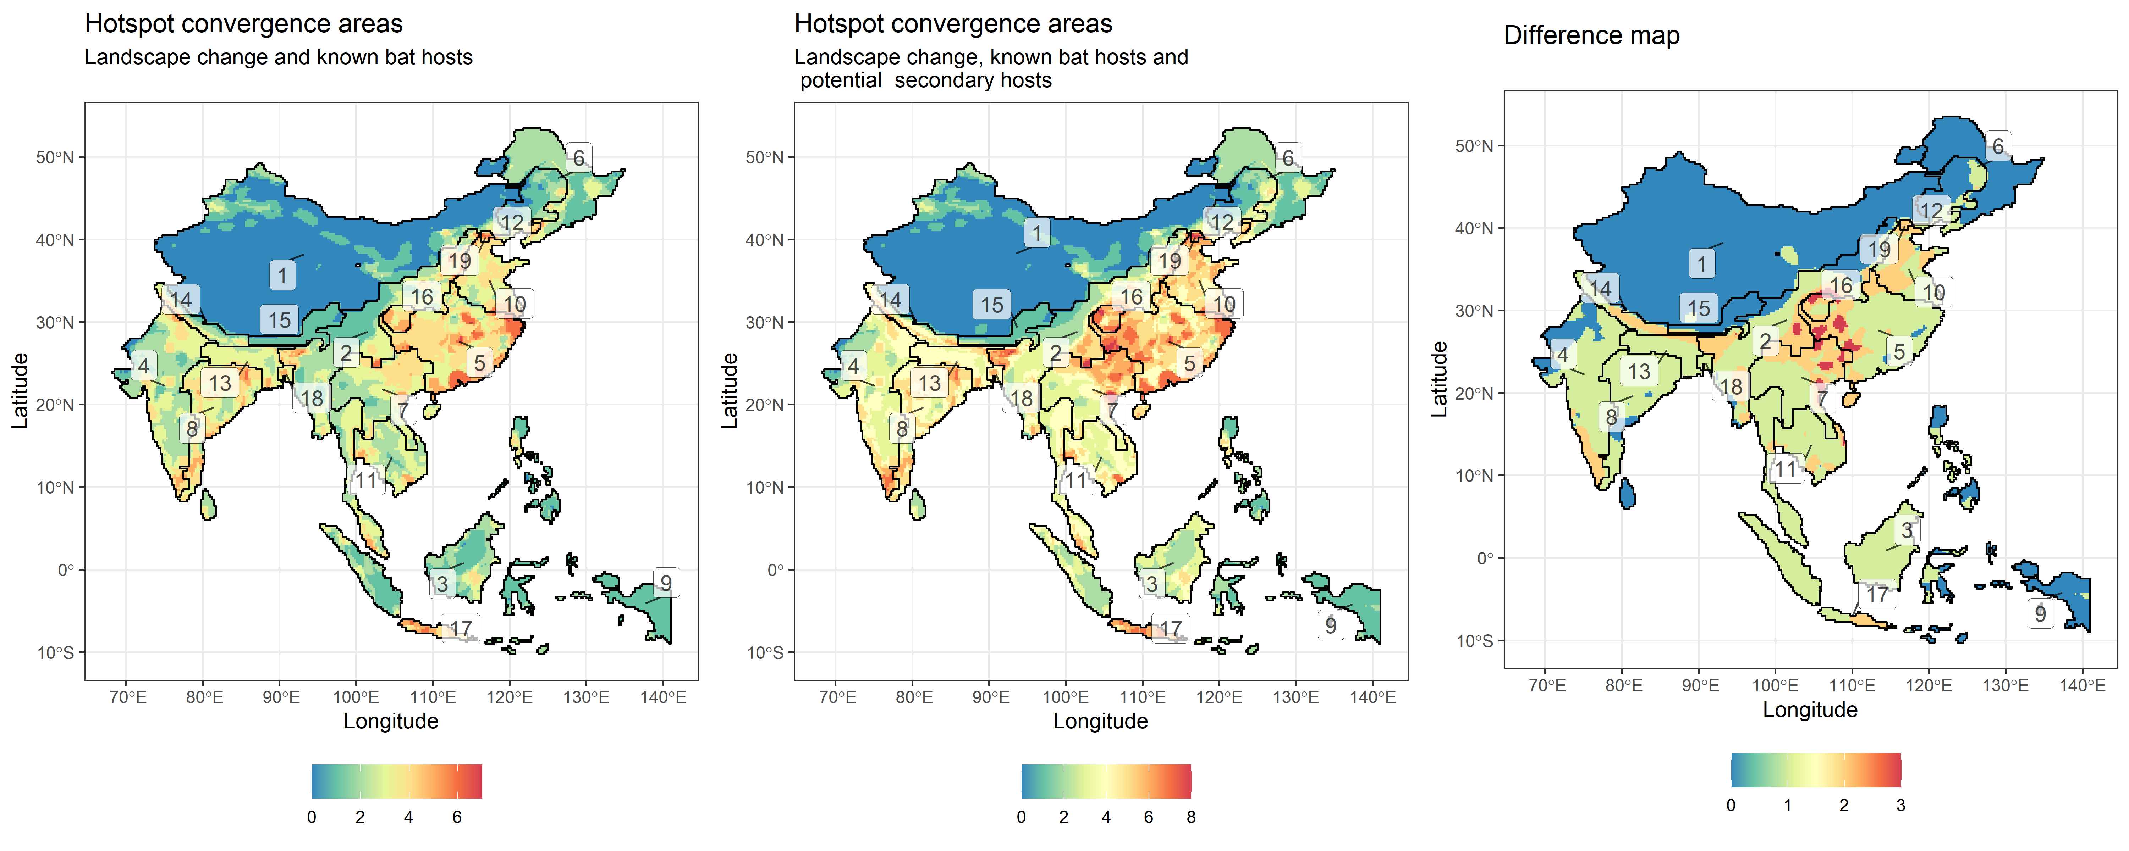
Figure 2 nested clusters

Slide 5
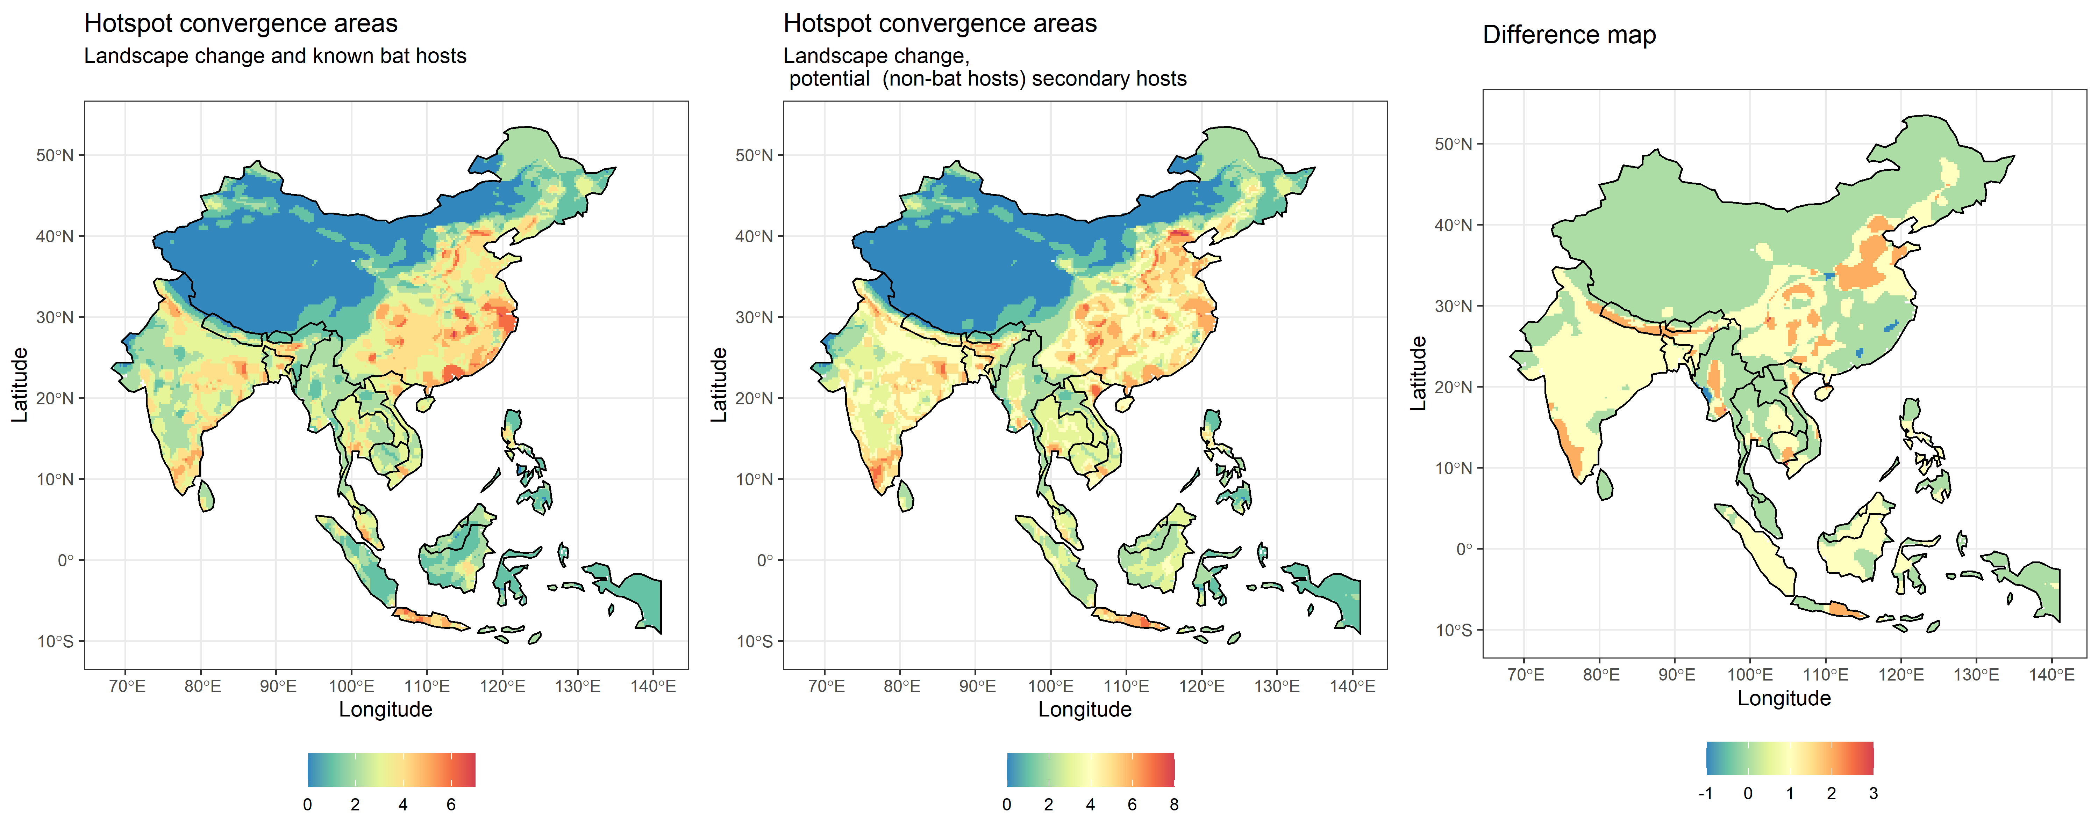
Figure 2 mmb
dif
-1 0 1 2 3
74 15908 8229 1580 5

Slide 6
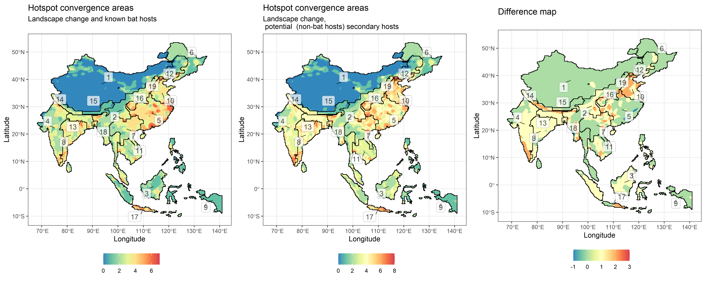
Figure 2 – mmb clusters

Slide 7
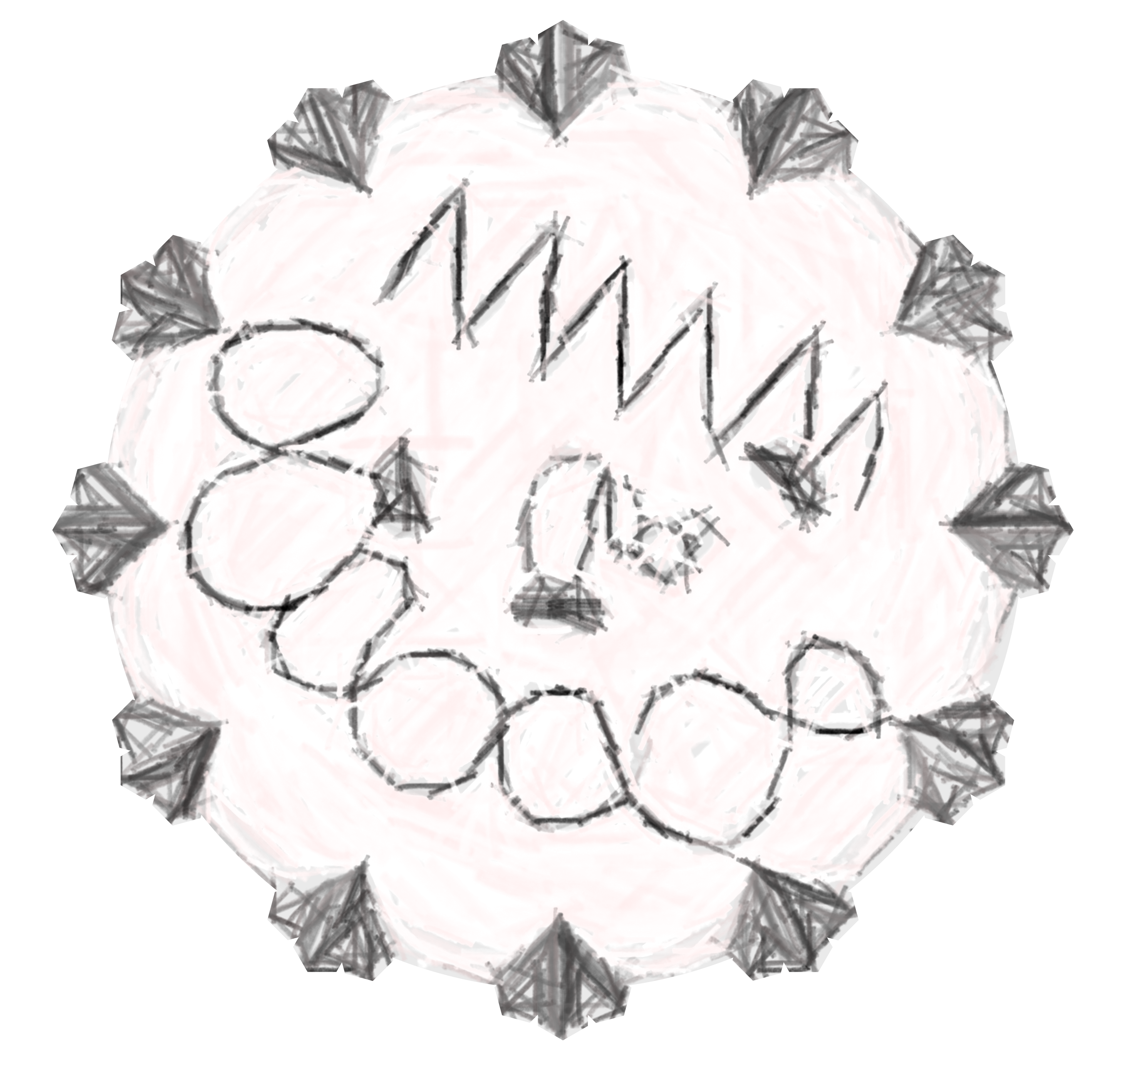
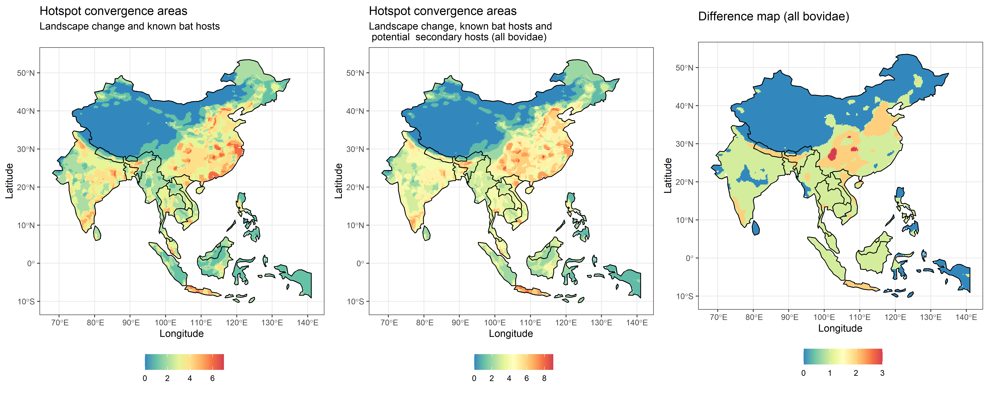
Figure 2 nested bovidae livestock

Slide 8
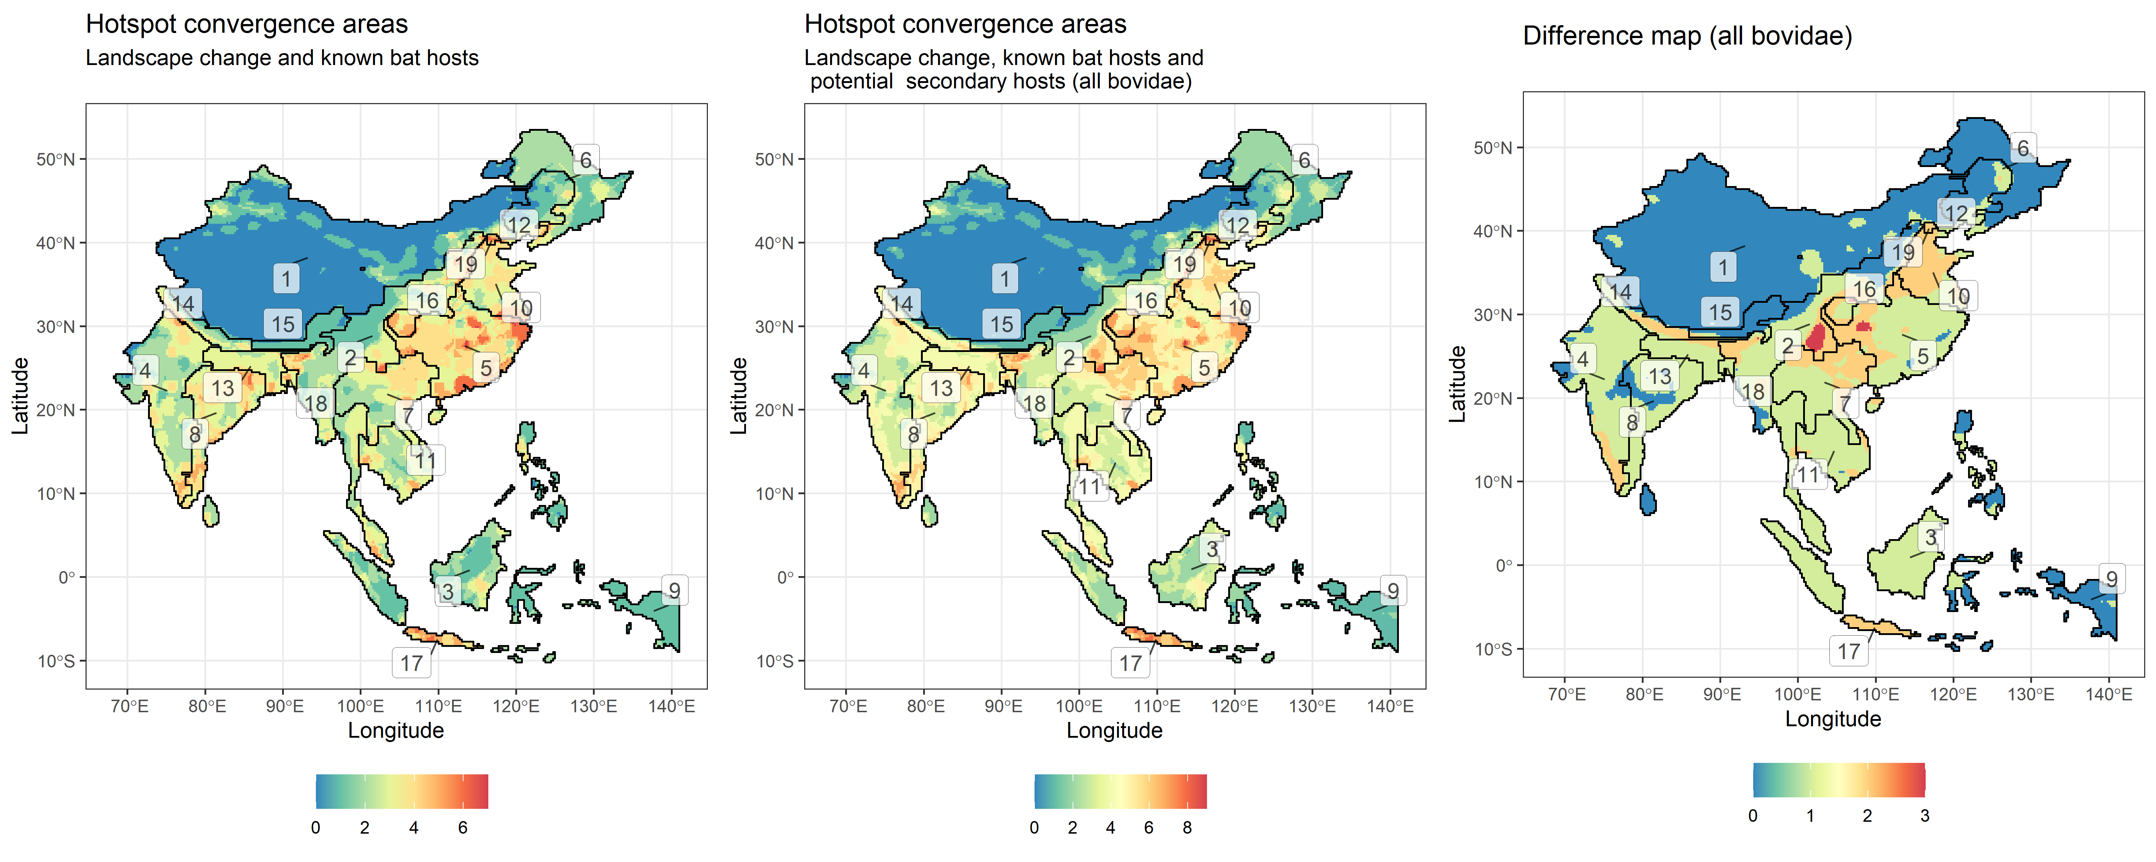
Figure 2 nested bovidae livestock clusters

Slide 9
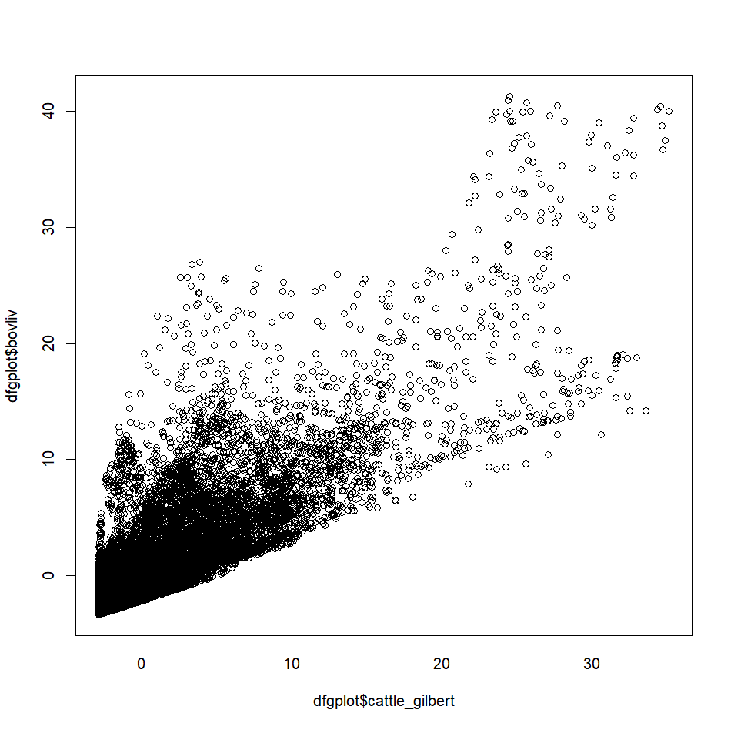
So apparently summing them makes the hotspots less intense, by spatially evenning out the values for livestock. This may be even more reallistic for hazard
> max(p$cattle_gilbert)
[1] 68677.8
> max(p$buffalo_cattle_goat_sheep)
[1] 104970.1

Slide 10
Figure 2 mmb clusters

Slide 11
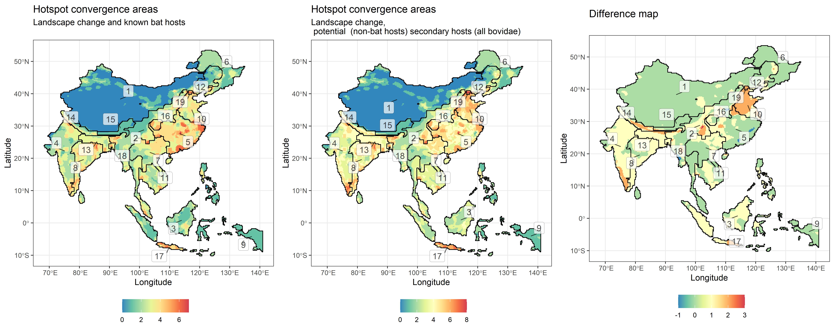
Figure 2 mmb bovidae livestock clusters

